Slide 1
REWARD-INDUCED REPRESENTATION LEARNING
Zhefei

Slide 2
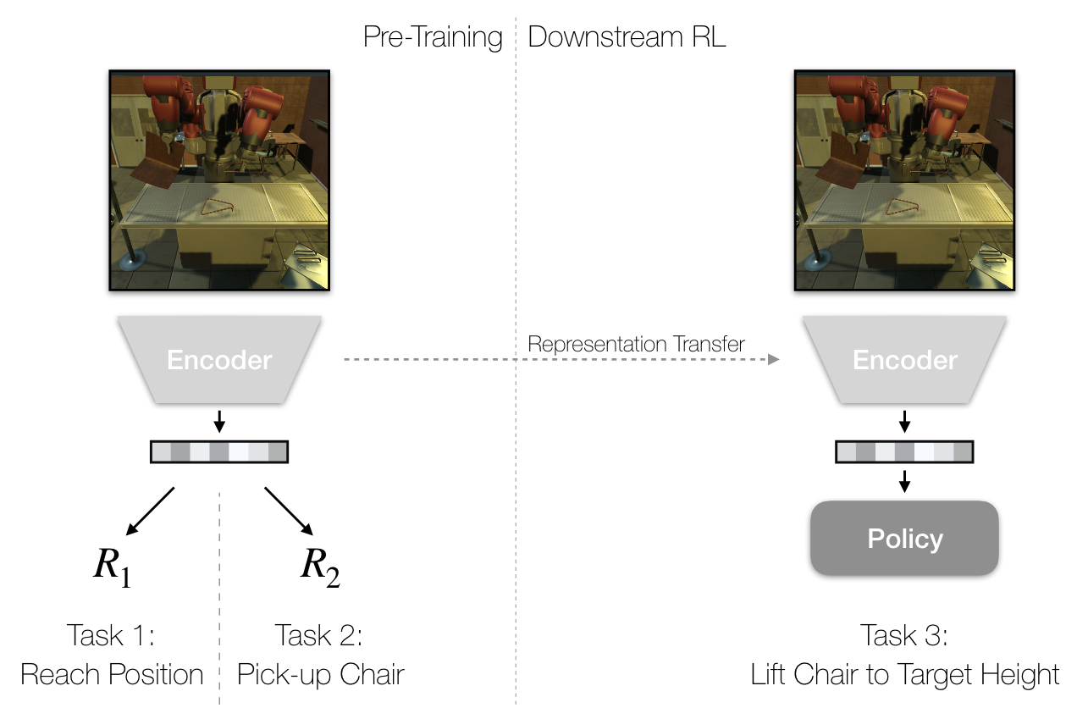
Reward
Induced
Paper
Tasks
Implementation
Thinking

Slide 3
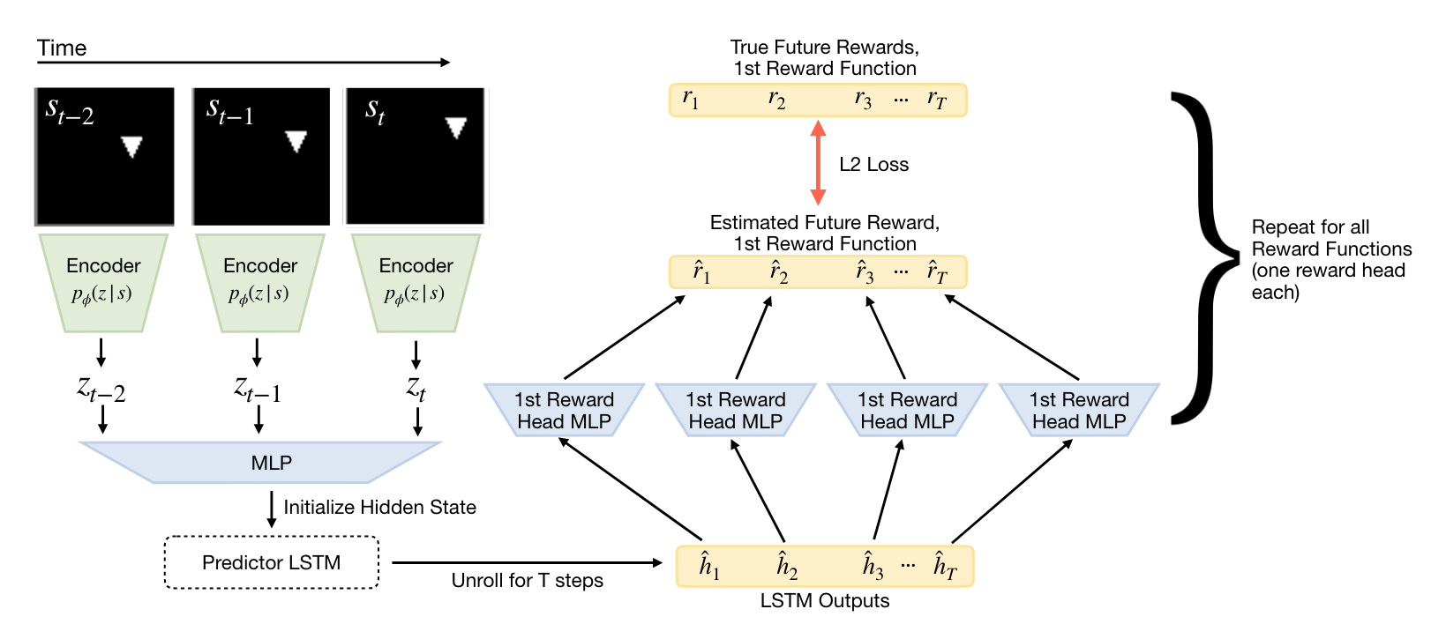
reward-induced
encoder
representation
Paper
Tasks
Implementation
Thinking

Slide 4
RL
representation
Paper
Tasks
Implementation
Thinking

Slide 5
✅Implement the reward-induced representation learning model.
✅Visualize your training results and verify that the model predicts correctly by replicating the results.
✅Implement an RL algorithm of your choice to train an agent that can follow a target shape (while ignoring distractor shapes) in the provided environment.
✅Train an image-based agent that encodes image observations using the pre-trained encoder.
✅(1) the image-based agent with pre-training should be able to follow the target shape with up to one distractor,
(2) it should learn faster than the image-based agent trained from scratch (but likely slower than the oracle).
Figure 2
Figure 3
Paper
Tasks
Implementation
Thinking

Slide 6
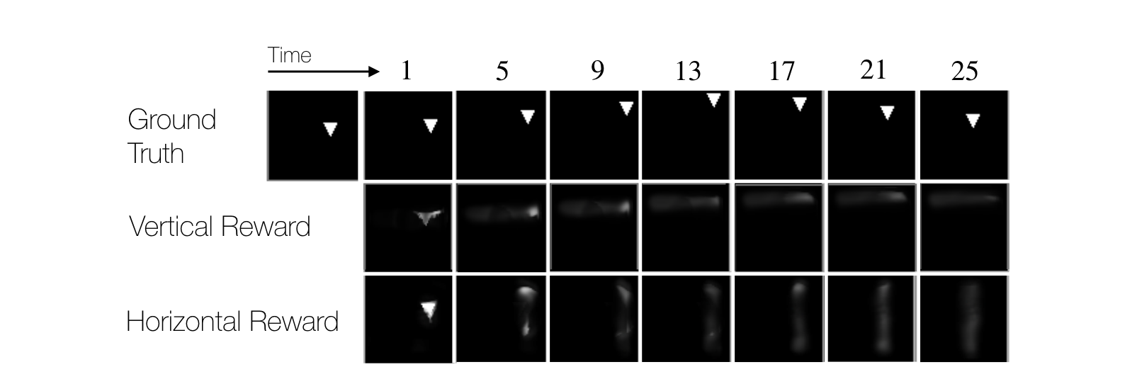
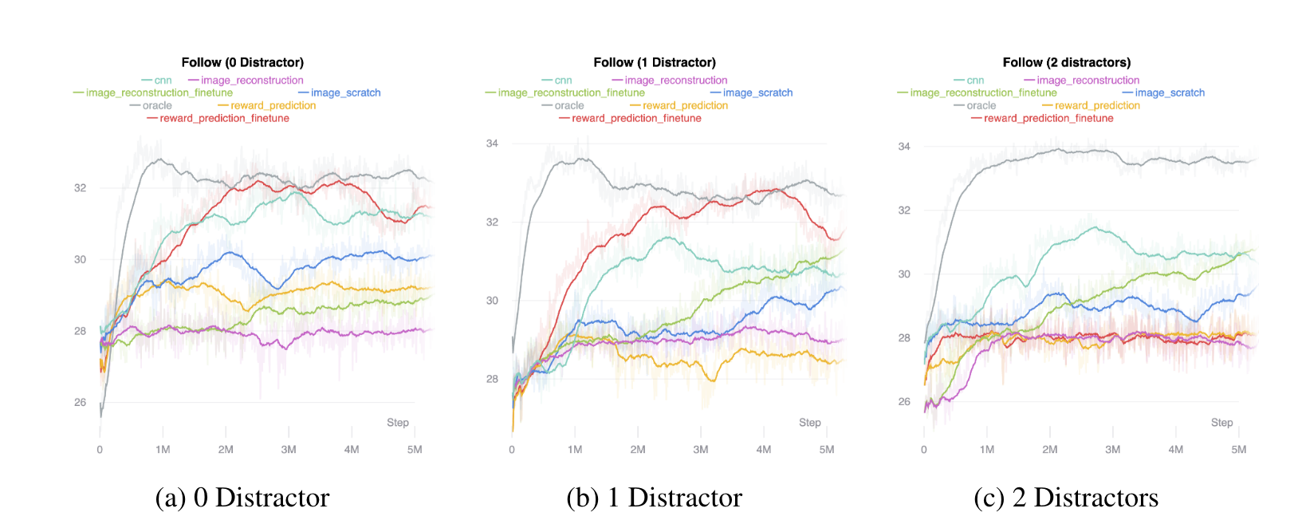
Representation Performance
Figure 2
Representation for Downstream RL
Figure 3
Paper
Tasks
Implementation
Thinking

Slide 7

Representation Performance
Figure 2
Representation for Downstream RL
Figure 3
Paper
Tasks
Implementation
Thinking

Slide 8
Representation Performance
Train a
Reward-Induced Encoder
Train a
Detached Decoder
Paper
Tasks
Implementation
Thinking

Slide 9
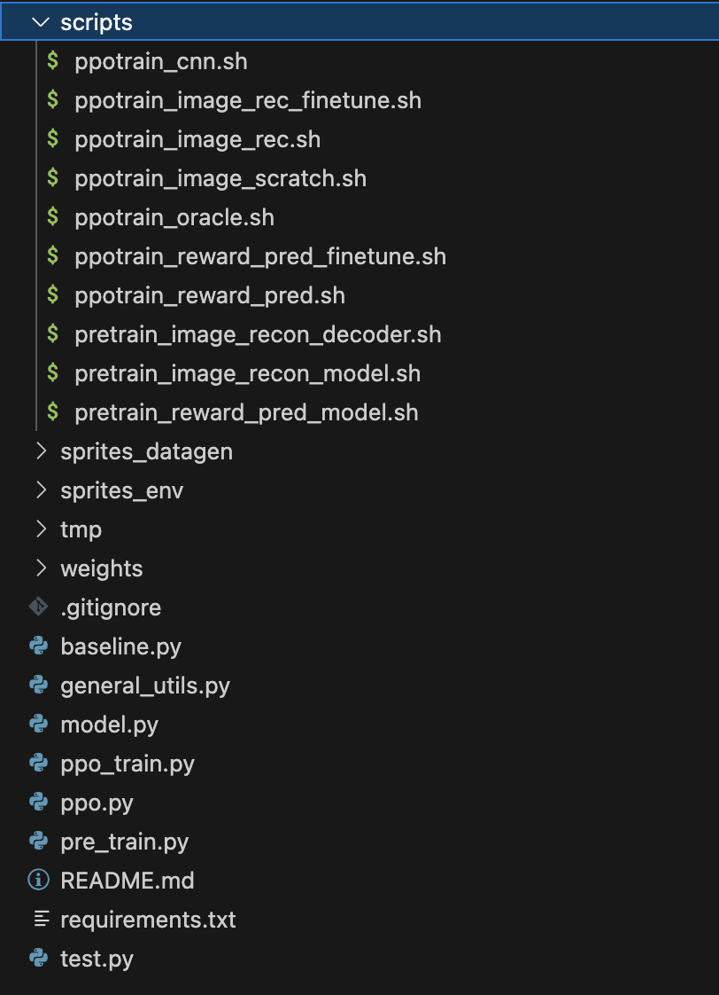
Train a
Reward-Induced Encoder
Train a
Detached Decoder
Horizontal & Vertical
Paper
Tasks
Implementation
Thinking

Slide 10
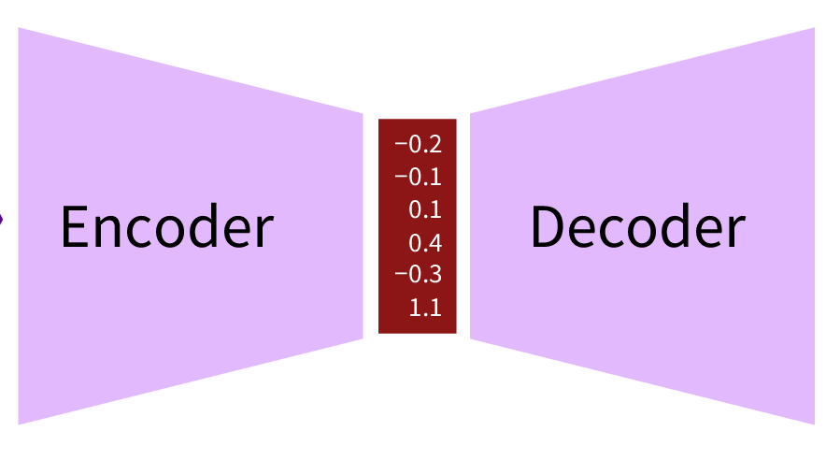
Train a
Reward-Induced Encoder
Train a
Detached Decoder
Detached
Paper
Tasks
Implementation
Thinking

Slide 11
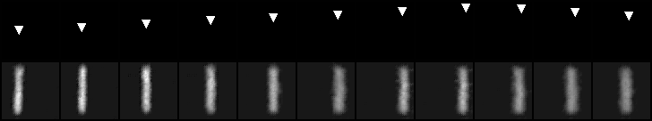
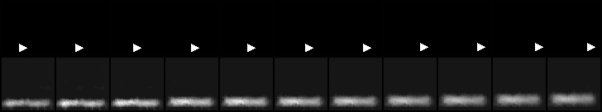
blur
horizontal
vertical
0
2
5
8
10
13
16
19
21
24
27
Paper
Tasks
Implementation
Thinking

Slide 12
Representation Performance
Figure 2
Representation for Downstream RL
Figure 3
Paper
Tasks
Implementation
Thinking

Slide 13
Representation Performance
Figure 2
Representation for Downstream RL
Figure 3
Paper
Tasks
Implementation
Thinking

Slide 14
Representation for Downstream RL
Multiple Representation Model
Downstream RL Task
Paper
Tasks
Implementation
Thinking

Slide 15
Representation for Downstream RL
Multiple Representation Model
Downstream RL Task
Paper
Tasks
Implementation
Thinking

Slide 16
Multiple Representation Model
Downstream RL Task
reward-prediction
with Pre-train
image-reconstruction
cnn
w/o Pre-train
image-scratch
oracle
Paper
Tasks
Implementation
Thinking

Slide 17
Multiple Representation Model
Downstream RL Task
reward-prediction
with Pre-train
image-reconstruction
cnn
w/o Pre-train
image-scratch
oracle
Paper
Tasks
Implementation
Thinking

Slide 18
Multiple Representation Model
Downstream RL Task
reward-prediction
image-reconstruction
Paper
Tasks
Implementation
Thinking

Slide 19
Multiple Representation Model
Downstream RL Task
reward-prediction
with Pre-train
image-reconstruction
3-Layer CNN
cnn
w/o Pre-train
image-scratch
same Encoder with random initialization
oracle
(x,y)-coordinates of the agent,target, and distractors
Paper
Tasks
Implementation
Thinking

Slide 20
Multiple Representation Model
Downstream RL Task
3-Layer CNN
cnn
image-scratch
same Encoder with random initialization
oracle
(x,y)-coordinates of the agent,target, and distractors
Paper
Tasks
Implementation
Thinking

Slide 21
Representation for Downstream RL
Multiple Representation Model
Downstream RL Task
Paper
Tasks
Implementation
Thinking

Slide 22
Representation for Downstream RL
Multiple Representation Model
Downstream RL Task
Paper
Tasks
Implementation
Thinking

Slide 23
Train a
Reward-Induced Encoder
Train a
Detached Decoder
RL
PPO
Policy
representation
Paper
Tasks
Implementation
Thinking

Slide 24
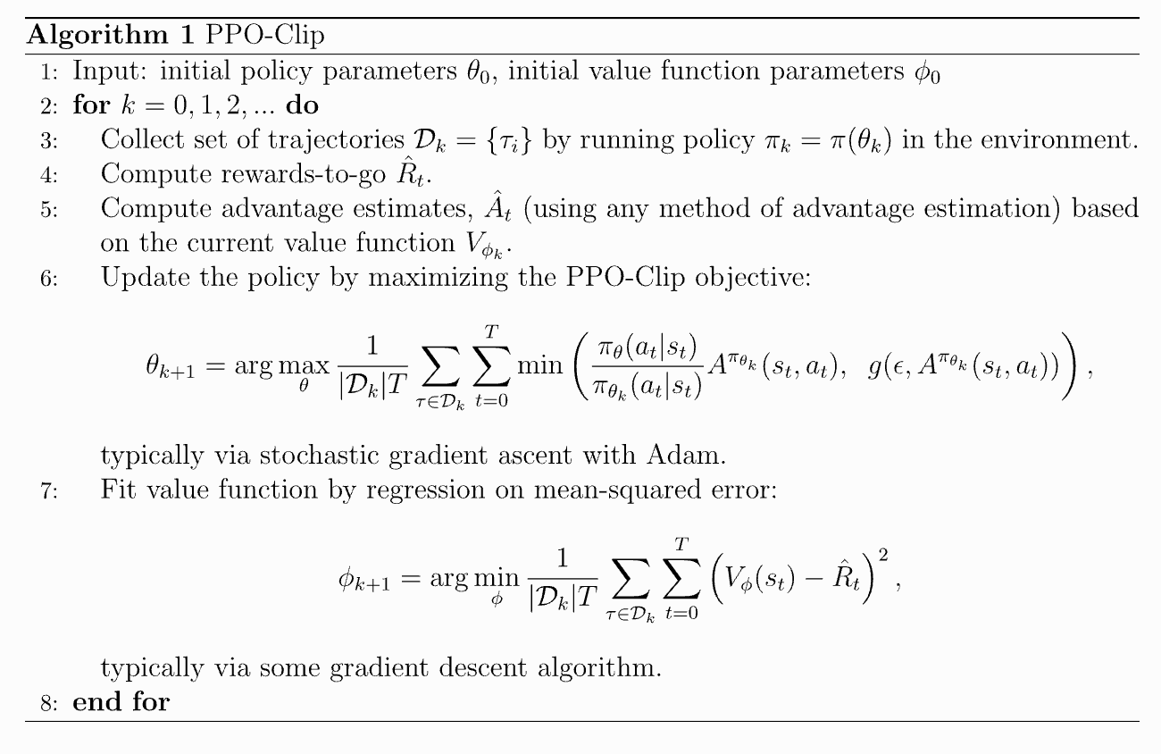
Train a
Reward-Induced Encoder
Train a
Detached Decoder
OpenAI
Paper
Tasks
Implementation
Thinking

Slide 25
Actor-Rollout
Critic-Update
Paper
Tasks
Implementation
Thinking

Slide 26
ENCODER
Policy-Net
Actor-Critic
DiagGaussianDistribution
PPO
Value-Net
Rollout-Buffer
Paper
Tasks
Implementation
Thinking

Slide 27
ENCODER
Policy-Net
Actor-Critic
DiagGaussianDistribution
PPO
Value-Net
Actor-Rollout
Rollout-Buffer
Paper
Tasks
Implementation
Thinking

Slide 28
ENCODER
Policy-Net
Actor-Critic
DiagGaussianDistribution
PPO
Value-Net
Rollout-Buffer
Paper
Tasks
Implementation
Thinking

Slide 29
ENV
observation
reward
ENCODER
Actor
Policy-Net
observation
DiagGaussianDistribution
Rollout-Buffer
reward
sample
action
logπ
action
logπ
Paper
Tasks
Implementation
Thinking

Slide 30
ENCODER
Policy-Net
Actor-Critic
DiagGaussianDistribution
PPO
Value-Net
Rollout-Buffer
Paper
Tasks
Implementation
Thinking

Slide 31
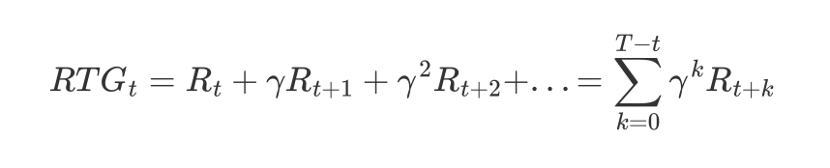
ENCODER
Policy-Net
Actor-Critic
DiagGaussianDistribution
PPO
Value-Net
Rollout-Buffer
logπ
observation
action
reward
RTGs
Cumulative Rewards
Paper
Tasks
Implementation
Thinking

Slide 32
ENCODER
Policy-Net
Actor-Critic
DiagGaussianDistribution
PPO
Value-Net
Rollout-Buffer
Paper
Tasks
Implementation
Thinking

Slide 33
Rollout-Buffer
logπ
observation
action
ENCODER
reward
RTGs
Value-Net
values
At
Paper
Tasks
Implementation
Thinking

Slide 34
ENCODER
Policy-Net
Actor-Critic
DiagGaussianDistribution
PPO
Value-Net
Actor-Rollout
Rollout-Buffer
Rollout-Buffer
observation
action
At
RTGs
logπ
Paper
Tasks
Implementation
Thinking

Slide 35
ENCODER
Policy-Net
Actor-Critic
DiagGaussianDistribution
PPO
Value-Net
Rollout-Buffer
Critic-Update
Paper
Tasks
Implementation
Thinking

Slide 36
ENCODER
Policy-Net
Actor-Critic
DiagGaussianDistribution
PPO
Value-Net
Rollout-Buffer
Rollout-Buffer
observation
Critic-Update
action
At
RTGs
logπ
Paper
Tasks
Implementation
Thinking

Slide 37


observation
action
ENCODER
Policy-Net
Value-Net
DiagGaussianDistribution
Critic
logπ’
values
logπ
RTGs
At
Paper
Tasks
Implementation
Thinking

Slide 38
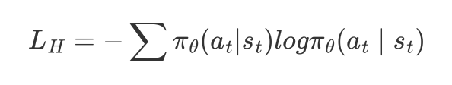
observation
action
ENCODER
Policy-Net
Value-Net
DiagGaussianDistribution
Critic
logπ’
values
logπ
RTGs
At
Paper
Tasks
Implementation
Thinking

Slide 39
ENCODER
Policy-Net
Actor-Critic
DiagGaussianDistribution
PPO
Value-Net
Rollout-Buffer
Paper
Tasks
Implementation
Thinking

Slide 40
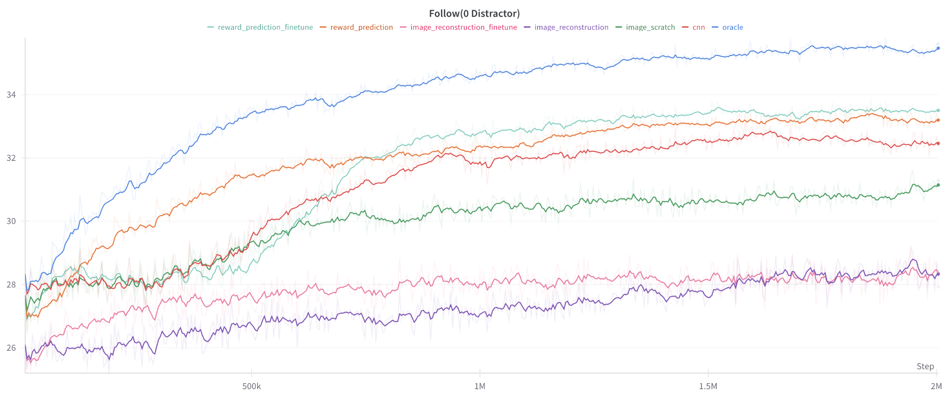
Results - 0 Distractor
Paper
Tasks
Implementation
Thinking

Slide 41
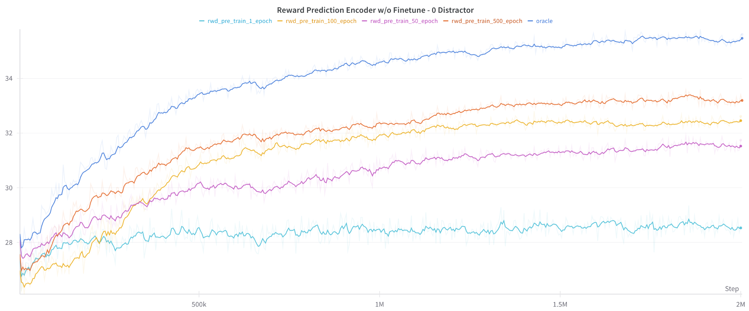
Results - Reward-Induced Encoder
Paper
Tasks
Implementation
Thinking

Slide 42
Results - Reward-Induced Encoder
20k timesteps
2000k timesteps
Paper
Tasks
Implementation
Thinking

Slide 43
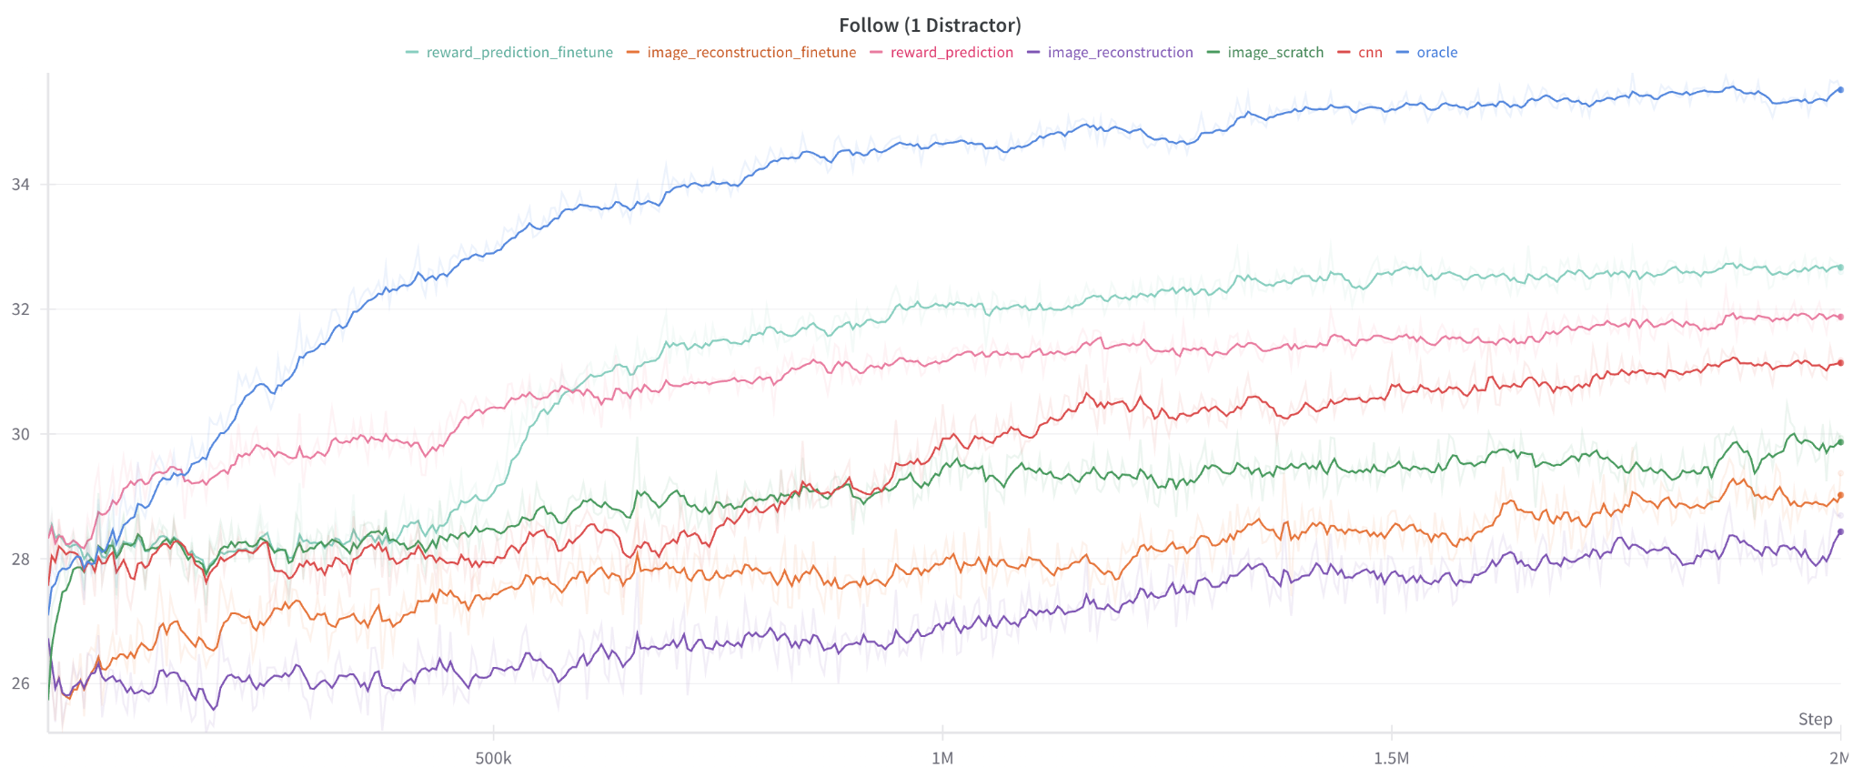
Results - 1 Distractor
Paper
Tasks
Implementation
Thinking

Slide 44
Results - Reward-Induced Encoder
20k timesteps
2000k timesteps
Paper
Tasks
Implementation
Thinking

Slide 45
Connection Between The Object-Centric Learning Project
🤔
Whether the Manipulation Consistency Loss could be a kind of reward to guide the training process of Downstream RL task?
Paper
Tasks
Implementation
Thinking

